Slide 1
Digital Signals in MATLAB
MATLAB - SECTION FOUR
Generating and plotting discrete-time sequences with stem
Under the supervision of DR. Lobna Abouelmagd
Prepared by ENG. Moamen Yasser
Notes:
Today we turn the math definitions of basic digital signals into MATLAB code: the unit impulse, the unit step, exponential and sinusoidal sequences, and shifted versions of each.

Slide 2
What we’ll build today
BEFORE WE START
PART 1
PART 2
PART 3
Basic sequences
Built on u(n)
Shifted sequences
The unit impulse δ(n) and the unit step u(n)
An exponential and a sinusoidal sequence, switched on by the unit step
δ(n − 2), a sum of shifted impulses, and u(n − 2)
Tools: ranges with a:b, zeros, for loops, if / elseif, element-wise .^ and .*, and stem plots

Slide 3
Digital Signals in MATLAB
MATLAB - SECTION FOUR
Part 1: Basic sequences
δ(n) and u(n) · Part 1 of 3

Slide 4
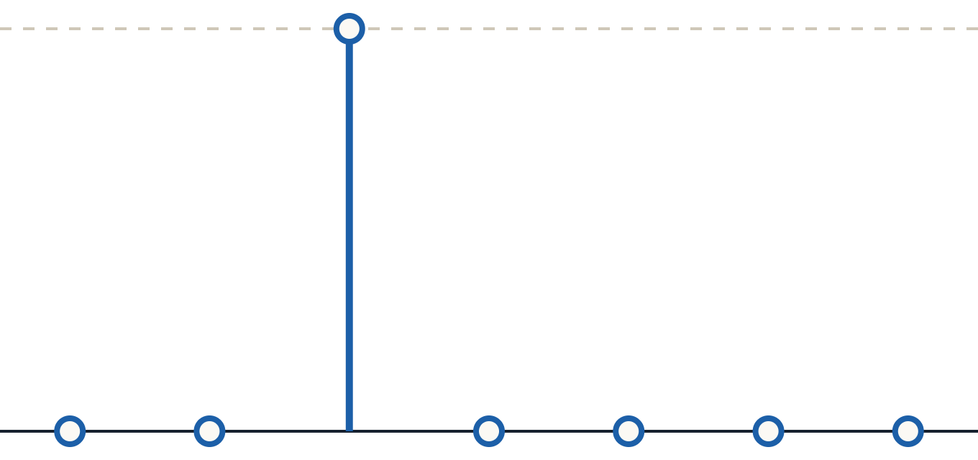
Unit impulse δ(n)
PART 1 · DEFINITION
The digital unit-impulse function is a single sample of height 1 at n = 0. Every other sample is 0.
DEFINITION
δ(n) = 1 when n = 0
−2
−1
0
1
2
3
4
δ(n) = 0 when n ≠ 0
0
0
1
0
0
0
0
Rows: n, then δ(n)
Notes:
The impulse is the simplest digital signal: one sample equal to 1 at n = 0, zero everywhere else. On the plot, the dashed line marks the value 1.

Slide 5
Drawing δ(n) with a for loop
PART 1 · CODE
How it works
n = -2:4;
s_im = zeros(size(n));
n = -2:4 makes the sample indices −2 to 4.
zeros(size(n)) starts every sample at 0.
The loop sets the sample where n == 0 to 1.
stem draws each sample as a line ending in a circle.
for i = 1:length(n)
if n(i) == 0
s_im(i) = 1;
end
end
stem(n, s_im);
title('Unit Impulse Function');
xlabel('n'); ylabel('\delta(n)');
grid on;
Notes:
The handout also prints each value inside the loop with fprintf('n(%i) = %i, s_im(%i) = %i\n', i, n(i), i, s_im(i)); — useful for checking the values in the Command Window. stem is used instead of plot because a digital signal only exists at whole-number n.

Slide 6
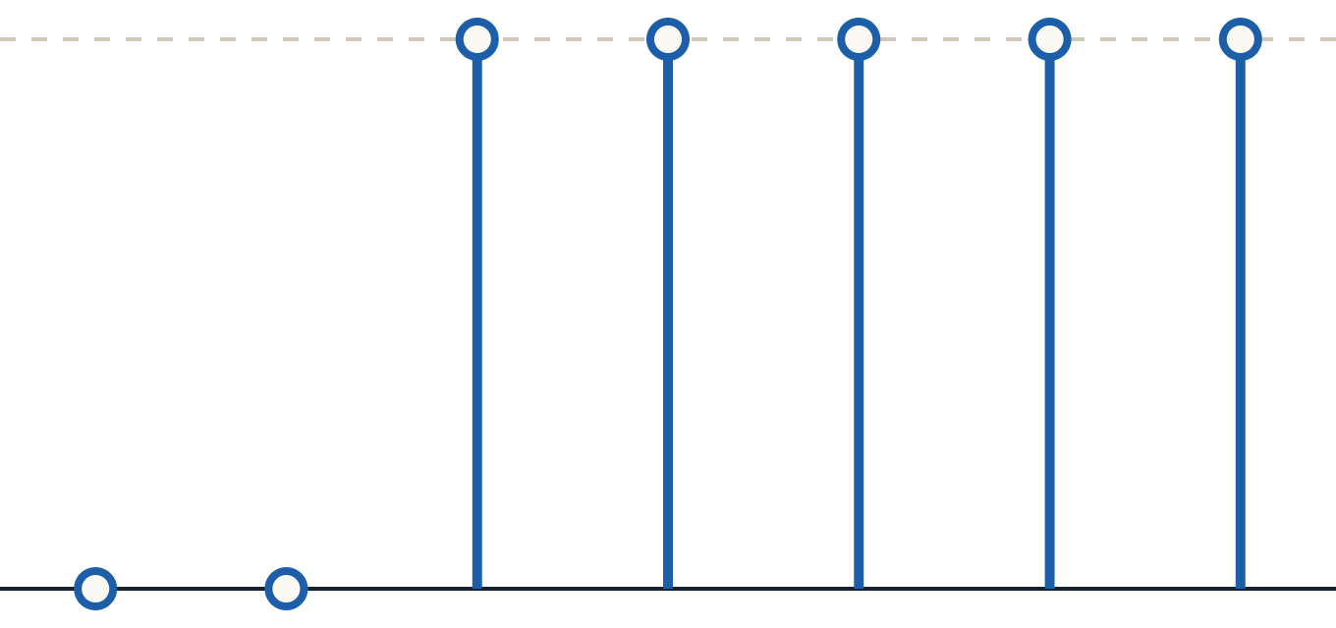
Unit step u(n)
PART 1 · DEFINITION
The digital unit-step function is 0 before n = 0 and 1 from n = 0 onward — it “switches on” a signal.
DEFINITION
u(n) = 1 when n ≥ 0
−2
−1
0
1
2
3
4
u(n) = 0 when n < 0
0
0
1
1
1
1
1
Rows: n, then u(n)
Notes:
Multiplying any sequence by u(n) keeps its values for n ≥ 0 and zeroes everything before n = 0. We use exactly that in Part 2.

Slide 7
Drawing u(n) with a for loop
PART 1 · CODE
What changed
n = -2:4;
u_shifted = zeros(size(n));
Only the condition. The impulse tests n(i) == 0 (one sample); the step tests n(i) >= 0 (every sample from 0 on).
for i = 1:length(n)
if n(i) >= 0
u_shifted(i) = 1;
end
Lab task: run this code, then change the range to n = -5:5 and plot again.
end
stem(n, u_shifted);
title('Unit Step Function');
xlabel('n'); ylabel('u(n)');
grid on;
Note: the handout’s title line has an extra quote at the end — write title('Unit Step Function');
Notes:
Point out the typo in the handout: title(' Unit Step Function''); ends with two quotes and MATLAB reports an error. The fixed line is shown in the code box.

Slide 8
Digital Signals in MATLAB
MATLAB - SECTION FOUR
Part 2: Sequences built on u(n)
Exponential and sinusoidal examples · Part 2 of 3

Slide 9
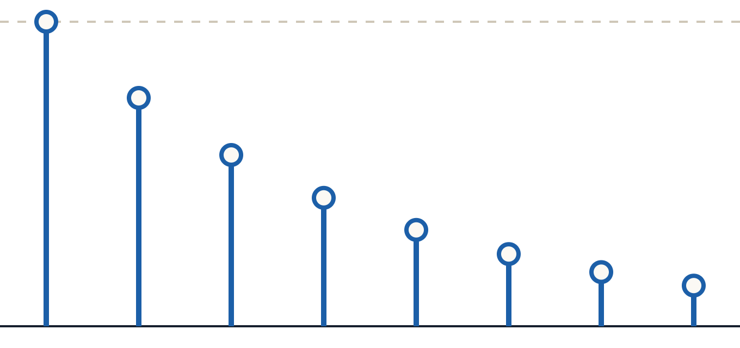
Exponential sequence
PART 2 · EXAMPLE 1
THE SIGNAL
x(n) = A (0.75)ⁿ u(n)
with A = 10, for the first eight samples n = 0 … 7
Each sample is 0.75 × the one before it, so the signal starts at 10 and decays toward 0.
0
1
2
3
4
5
6
7
10
7.50
5.63
4.22
3.16
2.37
1.78
1.33
Rows: n, then x(n) (Table 3.2, rounded)
Notes:
Exact values from Table 3.2: 10.0000, 7.5000, 5.6250, 4.2188, 3.1641, 2.3730, 1.7798, 1.3348. Because 0.75 is less than 1, the sequence decays.

Slide 10
Computing x(n) = 10(0.75)ⁿu(n)
PART 2 · EXAMPLE 1 CODE
Key operators
n = 0:7;
A = 10;
u_n = zeros(size(n));
.^
for i = 1:length(n)
Raises 0.75 to each value of n, element by element.
if n(i) >= 0
u_n(i) = 1;
end
end
.*
x_n = A * (0.75).^n .* u_n;
Multiplies by u(n) sample by sample, keeping only n ≥ 0.
stem(n, x_n); grid on;
title('Exponential Sequence');
xlabel('n'); ylabel('x(n)');
Notes:
Without the dot, ^ and * mean matrix power and matrix multiplication, which give an error here. The handout keeps the title 'Unit Step Function' and ylabel 'u(n)'; here they are relabelled to describe the signal actually plotted.

Slide 11
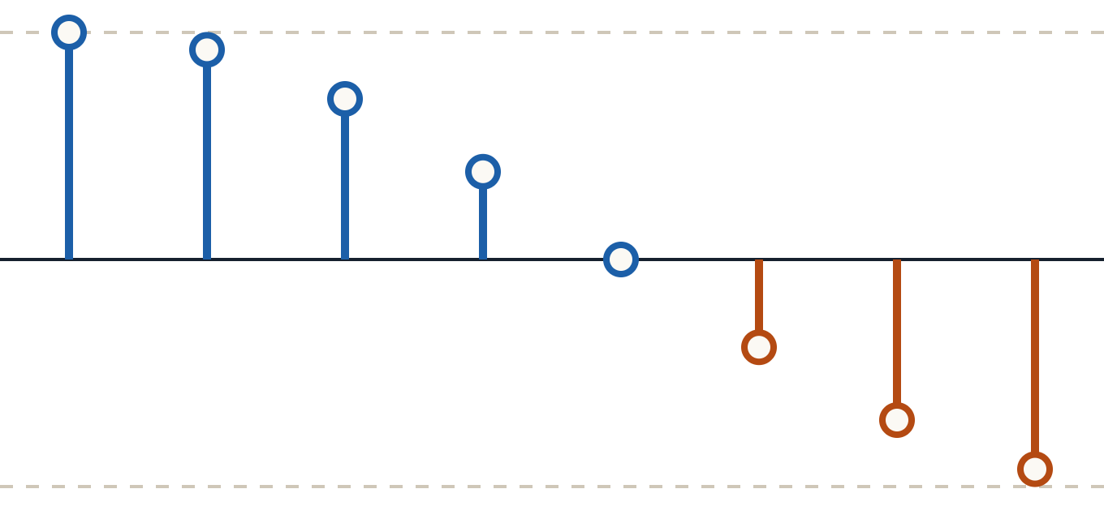
Sinusoidal sequence
PART 2 · EXAMPLE 2
THE SIGNAL
x(n) = A cos(0.125πn) u(n)
with A = 10, for the first eight samples n = 0 … 7
The samples follow a cosine: from 10 down through 0 at n = 4 to negative values.
0
1
2
3
4
5
6
7
10
9.24
7.07
3.86
0
−3.86
−7.07
−9.24
Rows: n, then x(n) (Table 3.1, rounded) · dashed lines at +10 and −10
Notes:
Exact values from Table 3.1: 10.0000, 9.2388, 7.0711, 3.8628, 0.0000, −3.8628, −7.0711, −9.2388. 0.125π = 2π/16, so one full cosine period takes 16 samples; we only see the first half here.

Slide 12
Computing x(n) = 10cos(0.125πn)u(n)
PART 2 · EXAMPLE 2 CODE
Same recipe, new signal
n = 0:7;
A = 10;
Only the line that computes x_n changes from Example 1.
u_n = zeros(size(n));
for i = 1:length(n)
if n(i) >= 0
pi is MATLAB’s built-in π.
cos works on the whole vector n at once.
.* u_n still switches the signal on at n = 0.
u_n(i) = 1;
end
end
x_n = A * cos(0.125*pi*n) .* u_n;
stem(n, x_n); grid on;
title('Sinusoidal Sequence');
xlabel('n'); ylabel('x(n)');
Notes:
Compare this code with Example 1 side by side: the u(n) loop and the plotting lines are identical; only x_n changes. That is the pattern for building any signal times u(n).

Slide 13
Digital Signals in MATLAB
MATLAB - SECTION FOUR
Part 3: Shifted sequences
δ(n − 2), sums of impulses, u(n − 2) · Part 3 of 3

Slide 14
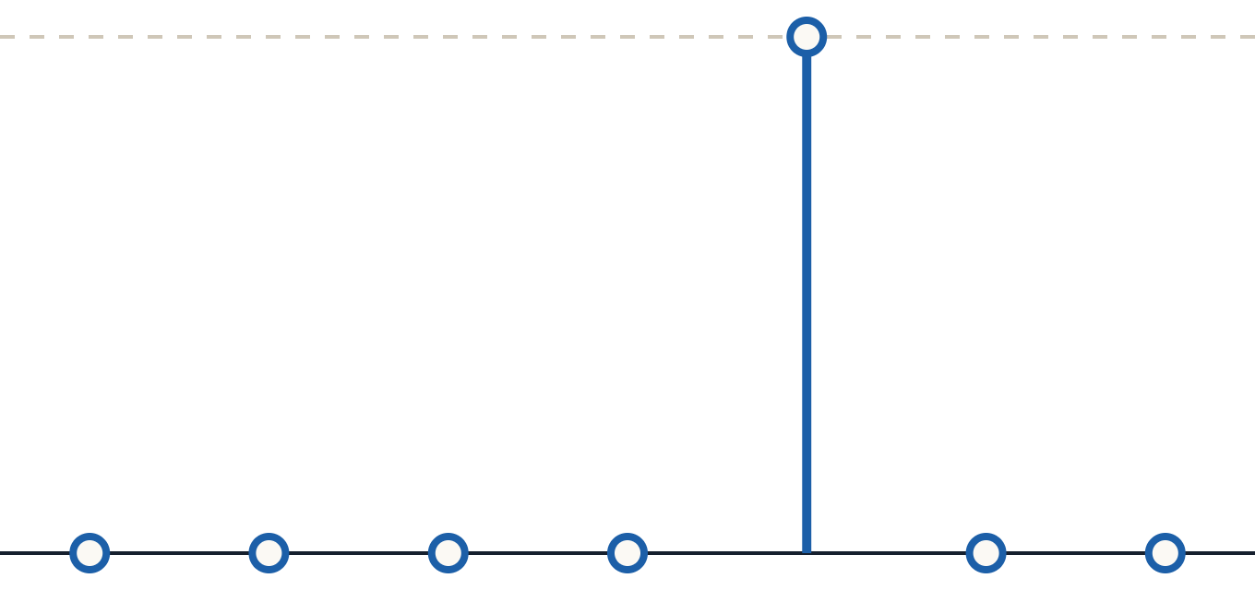
δ(n − 2): shift to the right
PART 3 · SHIFTED IMPULSE
n = -2:4;
s_im = zeros(size(n));
for i = 1:length(n)
if n(i) == 2
s_im(i) = 1;
end
end
stem(n, s_im);
title('The shifted unit-impulse');
−2
−1
0
1
2
3
4
xlabel('n'); ylabel('\delta(n-2)');
0
0
0
0
1
0
0
The spike moves from n = 0 to n = 2: test n(i) == 2.
Notes:
δ(n − 2) is 1 when n − 2 = 0, that is at n = 2. So the only change from the original impulse code is the condition n(i) == 2.

Slide 15
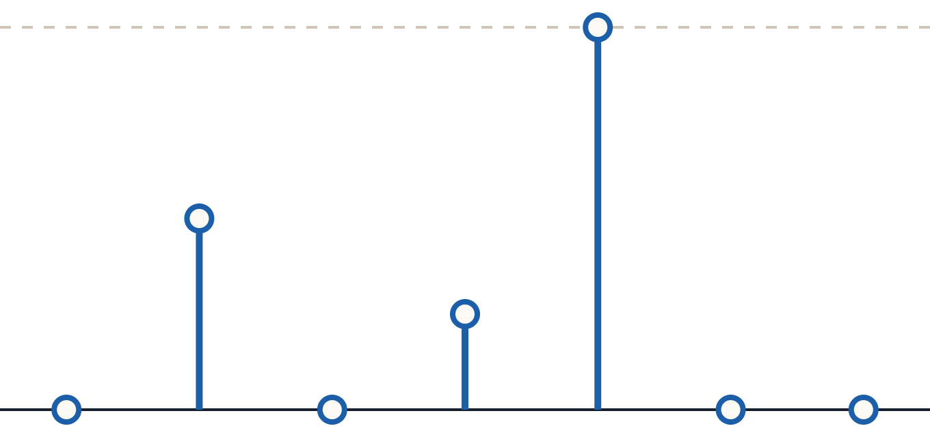
Combining shifted impulses
PART 3 · SUM OF IMPULSES
n = -2:4;
x(n) = δ(n+1) + 0.5δ(n−1) + 2δ(n−2)
s_im = zeros(size(n));
for i = 1:length(n)
if n(i) == -1
s_im(i) = 1;
elseif n(i) == 1
s_im(i) = 0.5;
elseif n(i) == 2
s_im(i) = 2;
end
end
−2
−1
0
1
2
3
4
stem(n, s_im); grid on;
0
1
0
0.5
2
0
0
title('Shifted Unit impuls');
Each term places one weighted spike · dashed line = 2
Notes:
Each term is an impulse moved to a new position and multiplied by a weight: δ(n+1) puts 1 at n = −1 (left shift), 0.5δ(n−1) puts 0.5 at n = 1, and 2δ(n−2) puts 2 at n = 2. The handout writes the conditions as separate if blocks in one version and as elseif in the other; both give the same result. Also drop the semicolon after the conditions (if n(i) == -1;) — MATLAB accepts it but it is not needed.

Slide 16
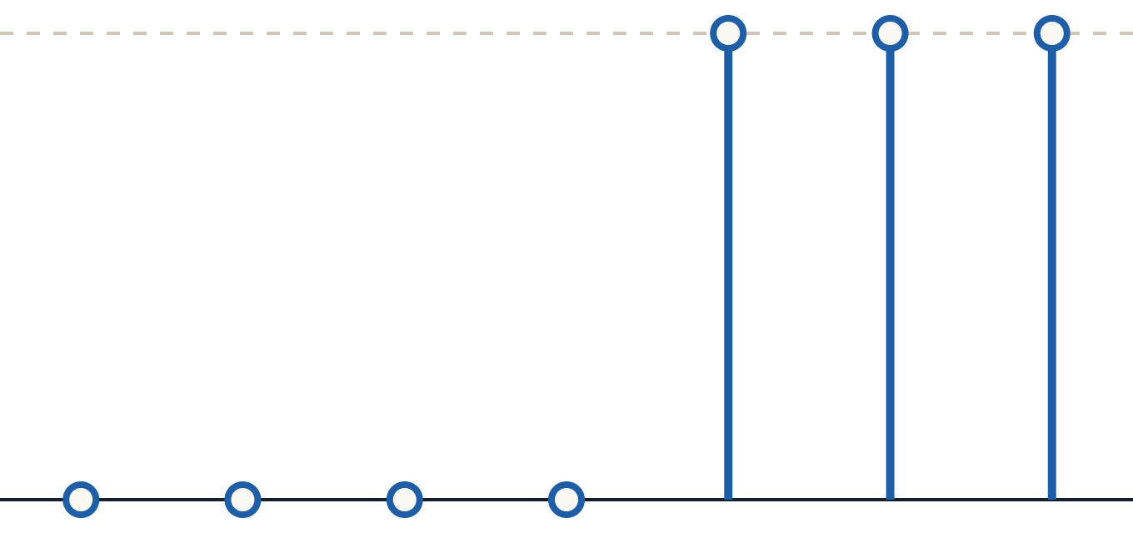
u(n − 2): the step starts later
PART 3 · SHIFTED STEP
n = -2:4;
u_n = zeros(size(n));
for i = 1:length(n)
if n(i) >= 2
u_n(i) = 1;
end
end
stem(n, u_n);
title('Unit step Function');
−2
−1
0
1
2
3
4
xlabel('n'); ylabel('u(n-2)');
grid on;
0
0
0
0
1
1
1
The step now switches on at n = 2: test n(i) >= 2.
Notes:
u(n − 2) is 1 when n − 2 ≥ 0, that is n ≥ 2. Same code as u(n) with the condition changed from 0 to 2.

Slide 17
Minus moves right, plus moves left
THE SHIFT RULE
x(n − k) · RIGHT BY k
x(n + k) · LEFT BY k
δ(n − 2)
δ(n + 1)
Spike lands at n = 2. In code: n(i) == 2
Spike lands at n = −1. In code: n(i) == -1
Quick check: set the inside of the brackets to zero and solve for n.

Slide 18
MATLAB tools from this section
SUMMARY
Code | What it does
n = -2:4 | Sample indices from −2 to 4
zeros(size(n)) | A vector of zeros the same size as n
for i = 1:length(n) | Visit every sample, one at a time
if / elseif / end | Pick which samples get a value
.^ and .* | Element-by-element power and multiply
stem(n, x) | Plot a digital signal as stems

Slide 19
Try these on your own
FURTHER PRACTICE
TASK 1
TASK 2
TASK 3
u(n + 1)
5(0.5)ⁿu(n)
2δ(n) − δ(n − 3)
Plot it for n = -3:5. Where does the step start?
Plot it for n = 0:9. Does it decay faster than Example 1?
Plot it for n = -2:5 using if / elseif.
Tip: start from the closest example code and change only the range, the condition or the formula.

Slide 20
Thank You
MATLAB - SECTION FOUR
Any questions?
Under the supervision of DR. Lobna Abouelmagd
Prepared by ENG. Moamen Yasser

